Slide 1

Probability and Random Variables

Slide 2
Outline
Definition of a Random Variable
Discrete Random Variables
Continuous Random Variables
Expectations, Variances
Exponential Distributions
Joint Probability Distributions
Marginal Probability Distributions
Covariance
Bivariate Normal Distributions

Slide 3
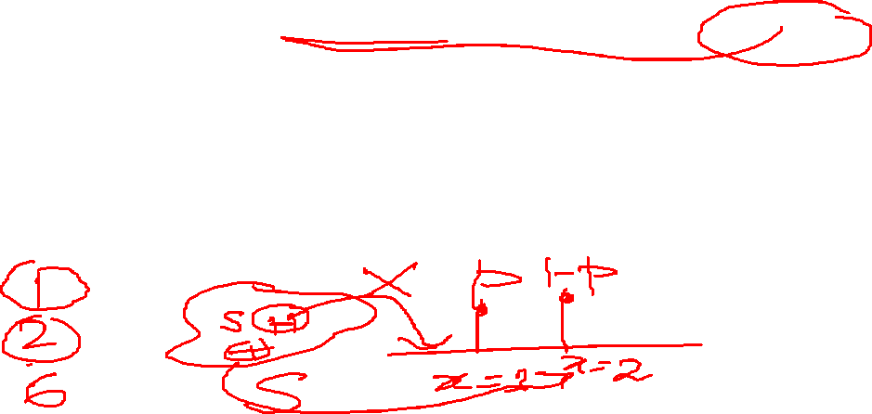
Definition of a Random Variable
A random variable is a real valued function defined on a sample space S. In a particular experiment, a random variable X would be some function that assigns a real number X(s) for each possible outcome
A discrete random variable can take a countable number of values.
Number of steps to the top of the Eiffel Tower*
A continuous random variable can take any value along a given interval of a number line.
The time a tourist stays at the top
once s/he gets there
Notes:
A random variable is a variable that assumes numerical values associated with the random outcome of an experiment, where one (and only one) numerical value is assigned to each sample point.

Slide 4
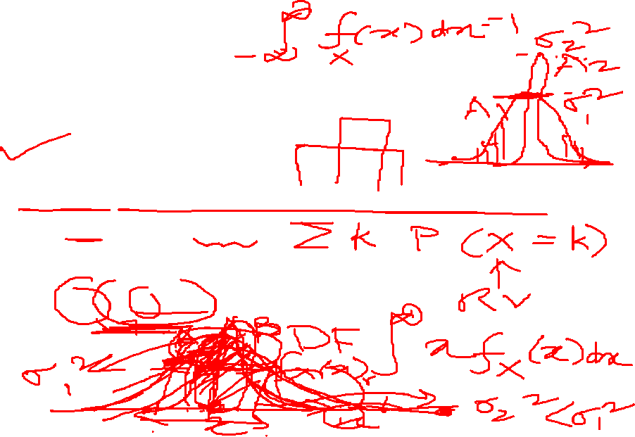
Probability Distributions, Mean and Variance for Discrete Random Variables
The probability distribution of a discrete random variable is defined as a function that specifies the probability associated with each possible outcome the random variable can assume.
p(x) ≥ 0 for all values of x
Σp(x) = 1
The mean, or expected value, of a discrete random variable is
The variance of a discrete random variable x is

Slide 5

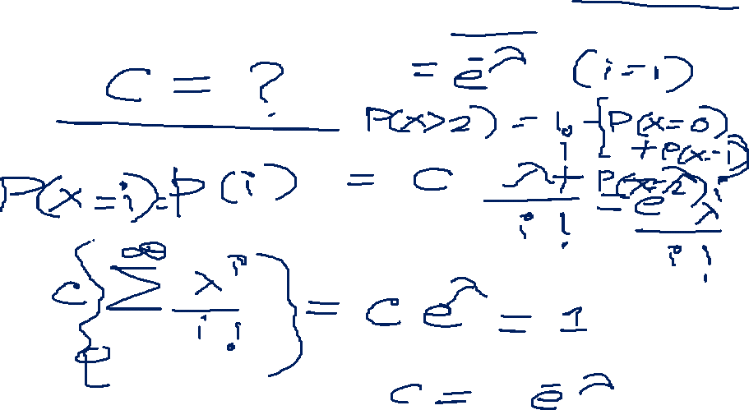

Slide 6
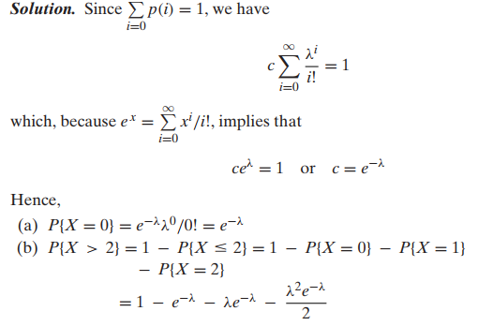

Slide 7


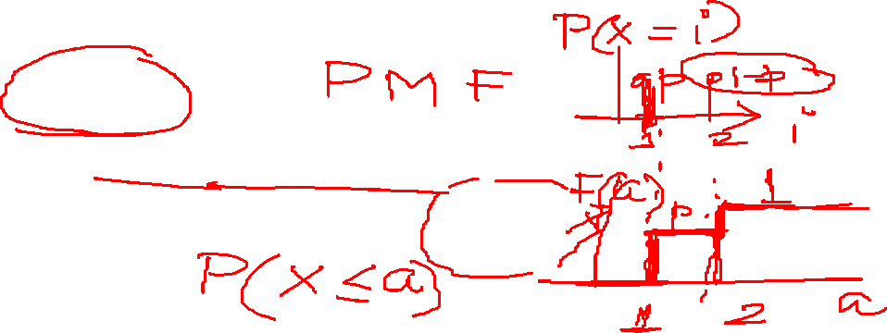
CDF

Slide 8
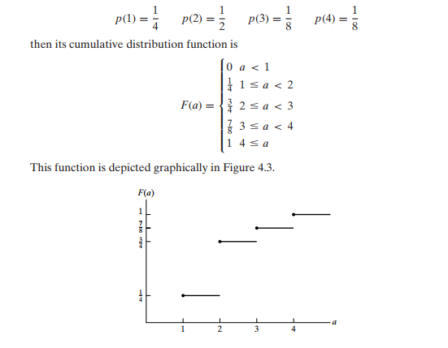
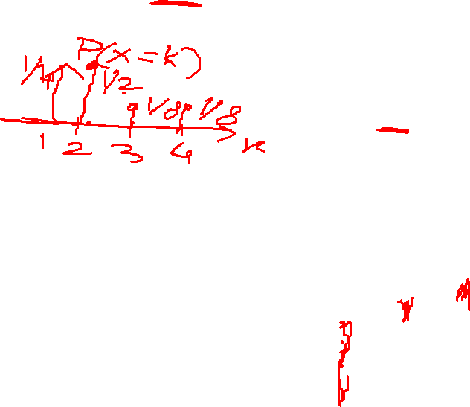

Slide 9
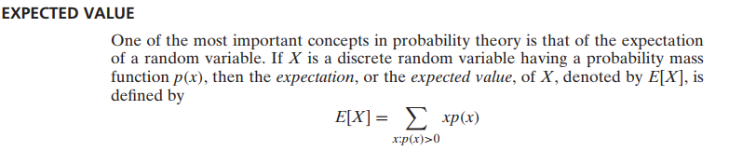
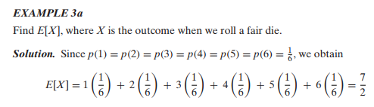
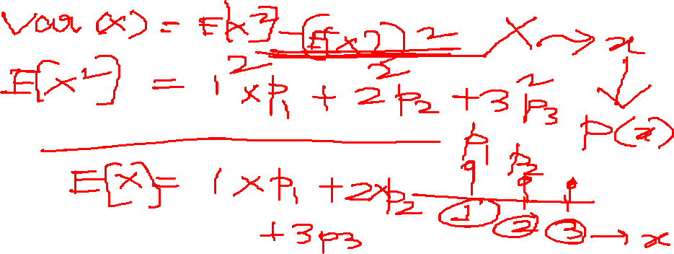
weighted average of the possible values of X

Slide 10
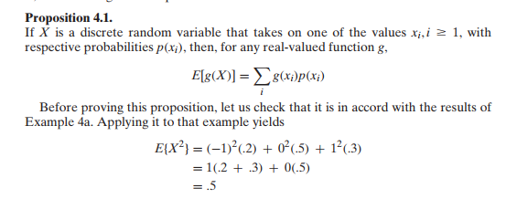
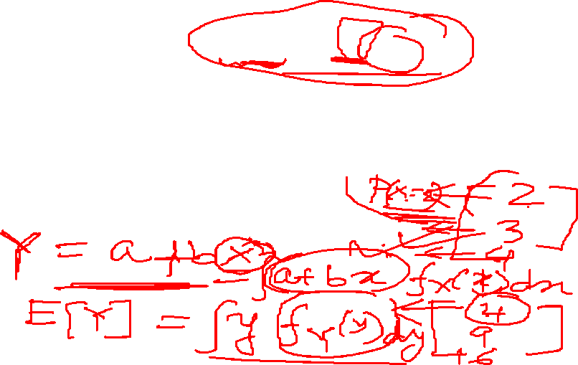

Slide 11
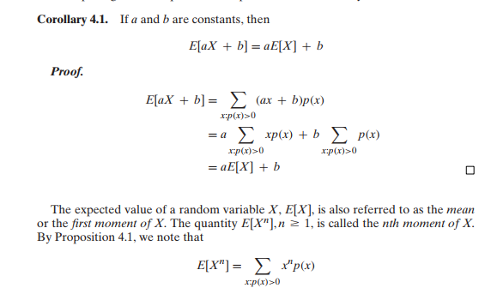
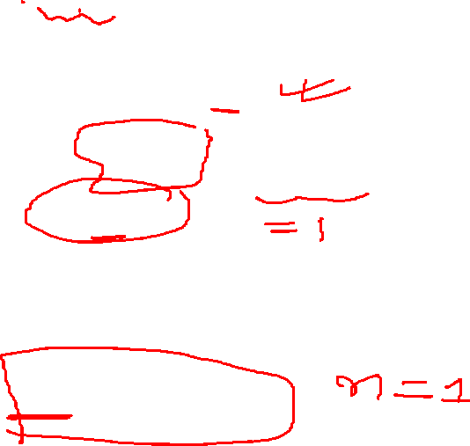

Slide 12
Variance
Given a random variable X along with its distribution function F, it would be extremely useful if we were able to summarize the essential properties of F by certain suitably defined measures.
One such measure would be E[X], the expected value of X.
However, although E[X] yields the weighted average of the possible values of X, it does not tell us anything about the variation, or spread, of these values.

Slide 13
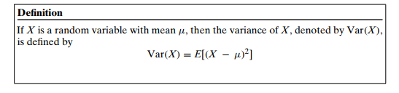

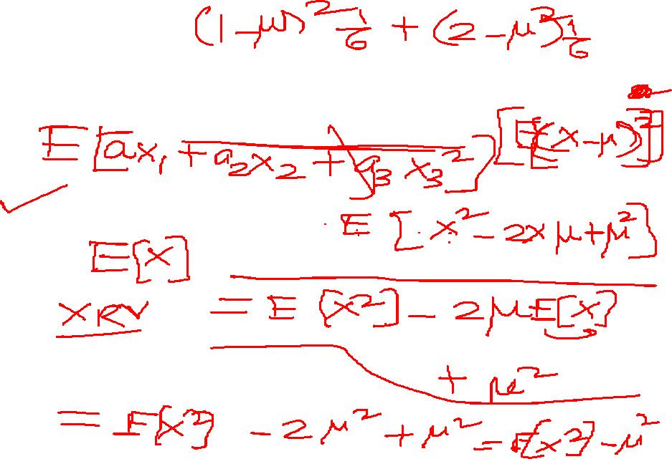

Slide 14
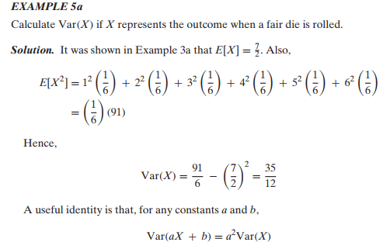
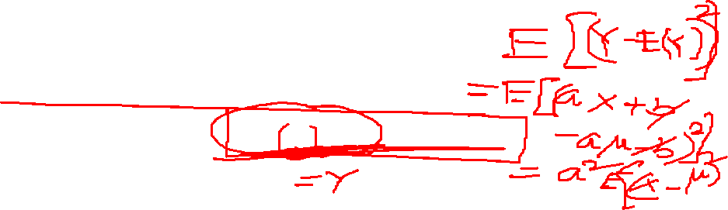

Slide 15
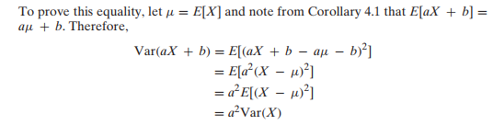



Slide 16

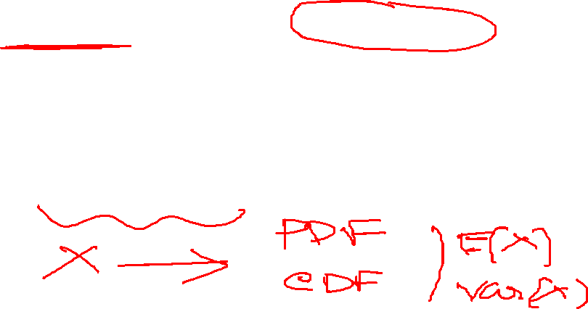
The Binomial Distribution
A Binomial Random Variable
n identical trials
Two outcomes: Success or Failure
P(S) = p; P(F) = q = 1 – p
Trials are independent
x is the number of S’s in n trials
Flip a coin 3 times
Outcomes are Heads or Tails
P(H) = .5; P(F) = 1-.5 = .5
A head on flip i doesn’t change P(H) of flip i + 1

Slide 17
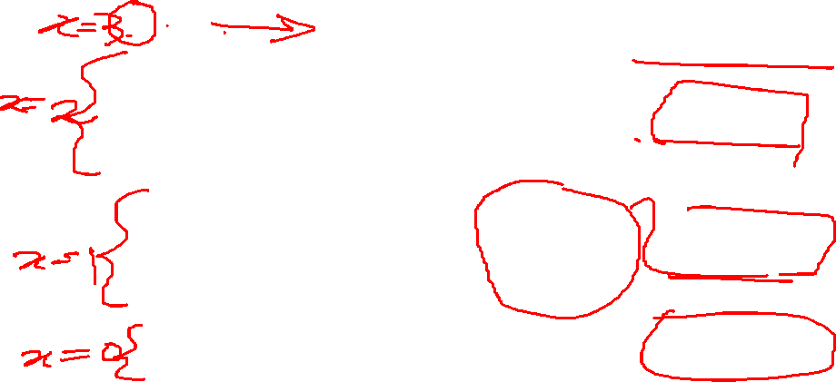
The Binomial Distribution (Example 1)
Results of 3 flips | Probability | Combined | Summary
HHH | (p)(p)(p) | p³ | (1)p³q⁰
HHT | (p)(p)(q) | p²q
HTH | (p)(q)(p) | p²q | (3)p²q¹
THH | (q)(p)(p) | p²q
HTT | (p)(q)(q) | pq²
THT | (q)(p)(q) | pq² | (3)p¹q²
TTH | (q)(q)(p) | pq²
TTT | (q)(q)(q) | q³ | (1)p⁰q³

Slide 18
The Binomial Distribution Probability Distribution
The probability of getting the required number of successes
The probability of getting the required number of failures
The number of ways of getting the desired results
Find the mean and variance of Binomial RV

Slide 19
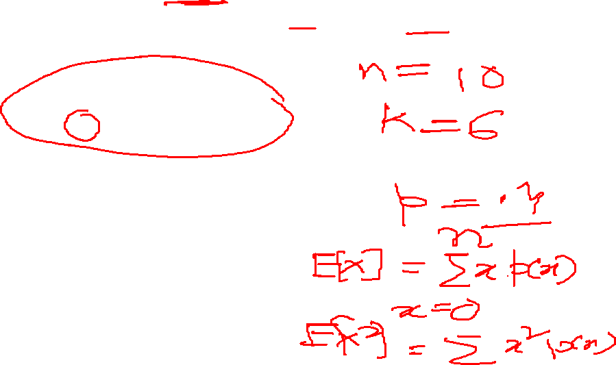
The Binomial Distribution Probability Distribution
Example 2: Say 40% of the class is female.
What is the probability that 6 of the first 10 students walking in will be female?

Slide 20
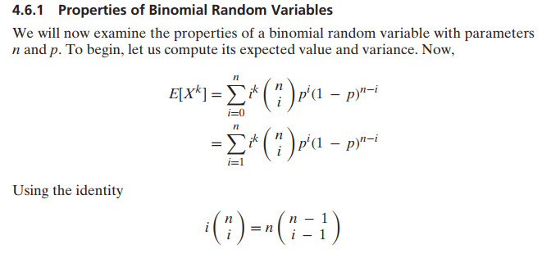
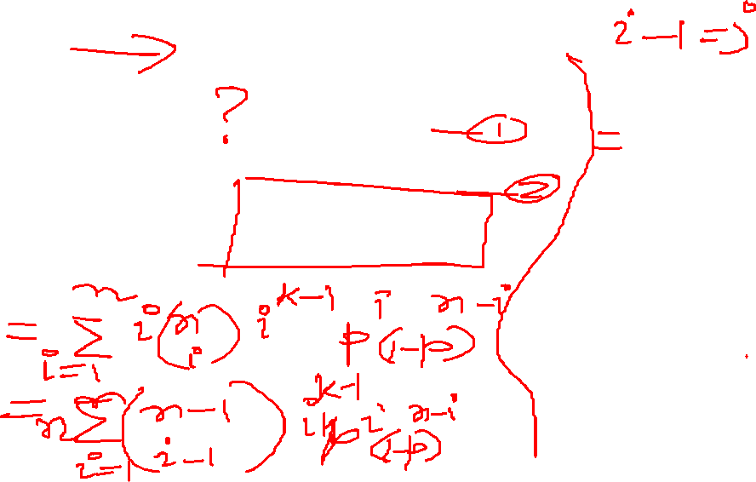

Slide 21
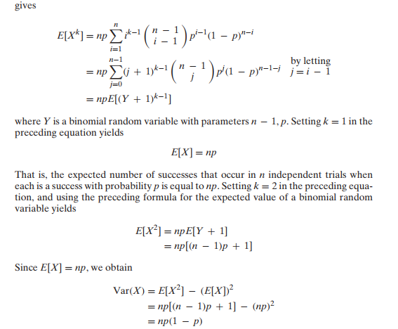
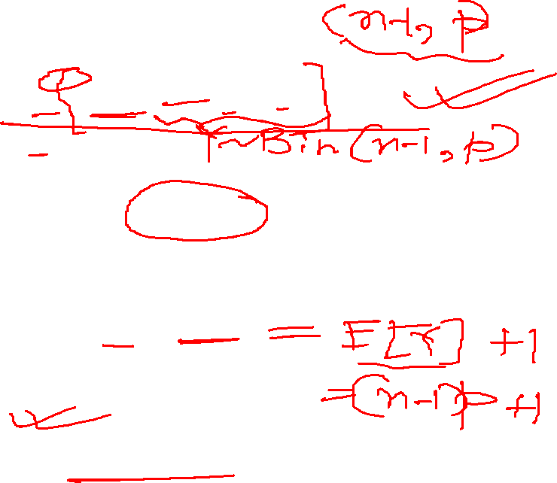

Slide 22
Mean and Variance of Binomial Distribution

Slide 24
The Poisson Distribution
Evaluates the probability of a (usually small) number of occurrences out of many opportunities in a …
period of time, area, volume, weight, distance and other units of measurement
● = mean number of occurrences in the given unit of time, area, volume, etc.
Mean µ = , variance: ² = 

Slide 25
The Poisson Distribution (Example 3)
Example 3: Say in a given stream there are an average of 3 striped trout per 100 yards. What is the probability of seeing 5 striped trout in the next 100 yards, assuming a Poisson distribution?

Slide 26
Continuous Probability Distributions
A continuous random variable can take any numerical value within some interval.
A continuous distribution can be characterized by its probability density function.
For example: for an interval (a, b],
The function f (x) is called the probability density function of X. Every p.d.f. f (x) must satisfy

Slide 27
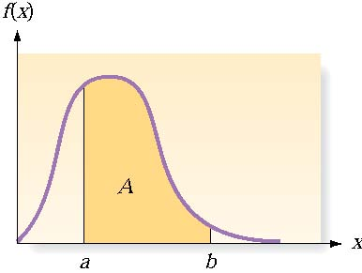
Continuous Probability Distributions
There are an infinite number of possible outcomes
P(x) = 0
Instead, find P(a<x≤b)
☺ Table
☺ Software
☹ Integral calculus
If a random variable X has a continuous distribution for which the p.d.f. is f(x), then the expectation E(X) and variance Var(X) are defined as follows:

Slide 28
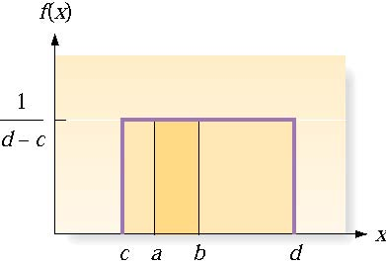
The Uniform Distribution on an Interval
For two values a and b
Mean and Variance

Slide 29
The Normal Distribution
The probability density function f(x):
µ = the mean of x,  = the standard deviation of x
Notes:
Closely approximates many situations
Perfectly symmetrical around its mean

Slide 30
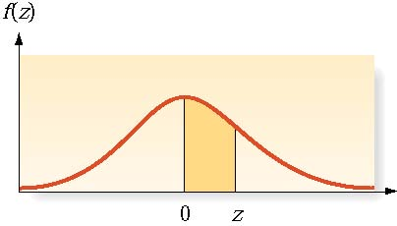
The Normal Distribution (Cont.)
Example 4: Say a toy car goes an average of 3,000 yards between recharges, with a standard deviation of 50 yards (i.e., µ = 3,000 and  = 50) .
What is the probability that the car will go more than 3,100 yards without recharging?
A popular model for the change in the price of a stock over a period of time of length u is:
Notes:
Closely approximates many situations
Perfectly symmetrical around its mean

Slide 31
The Exponential Distribution
Probability Distribution for an Exponential Random Variable x
Probability Density Function
Mean: Variance:

Slide 32
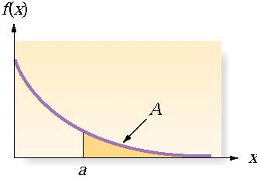
The Exponential Distribution (Example 5)
Example 5: Suppose the waiting time to see the nurse at the student health center is distributed exponentially with a mean of 45 minutes. What is the probability that a student will wait more than an hour to get his or her generic pill?

Slide 33
Normal, Exponential Distribution (Matlab)
>p = normcdf([-1 1],0,1);
>P(2)-p(1)
P = normcdf(X,mu,sigma) computes the normal cdf at each of the values in X using the corresponding parameters in mu and sigma. X, mu, and sigma can be vectors, matrices, or multidimensional arrays that all have the same size.
Example 4:
>p=1-normcdf(3100,3000,50)
>p =
0.0228
P = expcdf(X,mu)
P = expcdf(X,mu) computes the exponential cdf at each of the values in X using the corresponding parameters in mu. The parameters in mu must be positive.
Example 5:
>mu=45;
>> p=1-expcdf(60,45)
p =
0.2636

Slide 34
Joint Probability Distributions
In general, if X and Y are two random variables, the probability distribution that defines their simultaneous behavior is called a joint probability distribution.
For example: X : the length of one dimension of an injection-molded part, and Y : the length of another dimension. We might be interested in
P(2.95 ≤ X ≤ 3.05 and 7.60 ≤ Y ≤ 7.80).

Slide 35
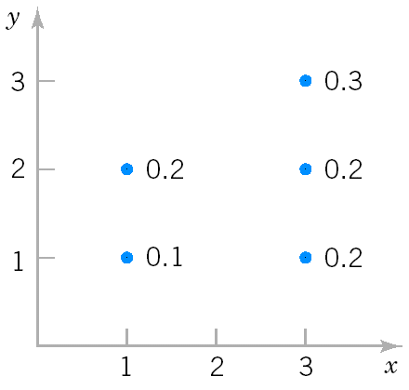
Discrete Joint Probability Distributions
The joint probability distribution of two discrete random variables X,Y is usually written as f_{XY}(x,y)= Pr(X=x, Y=y). The joint probability function satisfies
Example 6: X can take only 1 and 3; Y can take only 1,2 and 3 ; and the joint probability function of X and Y is:
Compute P(X≥2, Y≥2)
P(X≥2, Y≥2)=P(X=3,Y=2)+P(X=3,Y=3)=0.2+0.3=0.5
(2) Compute Pr(X=3)
P(X=3)=P(X=3,Y=1)+P(X=3,Y=2)+P(X=3,Y=3)=0.2+0.2+0.3=0.7
Joint distribution of X and Y

Slide 36
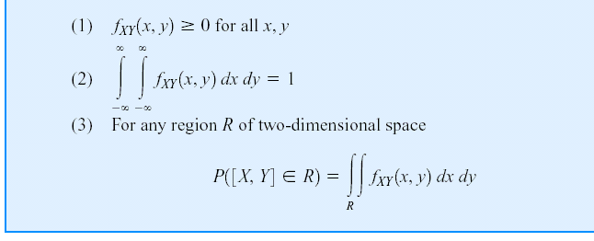
Continuous Joint Distributions
A joint probability density function for the continuous random variables X and Y, denotes as f_{XY}(x,y), satisfies the following properties:

Slide 38
Continuous Joint Distributions (Example 7)
Calculating probabilities from a joint p.d.f.

Slide 39
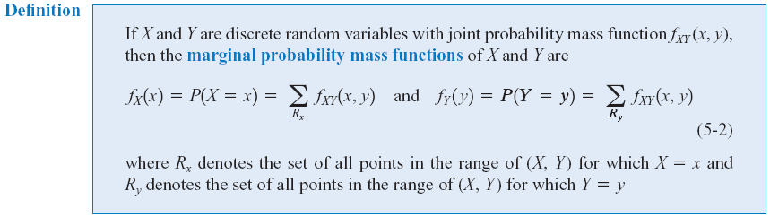
Marginal Probability Distributions (Discrete)
Marginal Probability Distribution: the individual probability distribution of a random variable computed from a joint distribution.
Notes:
In other words, for every value x, the value of fX(x) is found by summing fXY(x,y) over all possible values y of Y.

Slide 40
Marginal Probability Distributions (Discrete, Example)
Compute f_{X}(1), f_{X}(3), f_{Y}(1), f_{Y}(2) and f_{Y}(3) in Example 6 .
f_{X}(1)=P(X=1,Y=1)+P(X=1,Y=2)=0.1+0.2=0.3
f_{X}(3)= P(X=3,Y=1)+P(X=3,Y=2)+ P(X=3,Y=3)=0.2+0.2+0.3=0.7
f_{Y}(1)= P(X=1,Y=1)+P(X=3,Y=1)=0.1+0.2=0.3
f_{Y}(2)=P(X=1,Y=2)+P(X=3,Y=2)=0.2+0.2=0.4
f_{Y}(3)= P(X=3,Y=3)=0.3

Slide 41
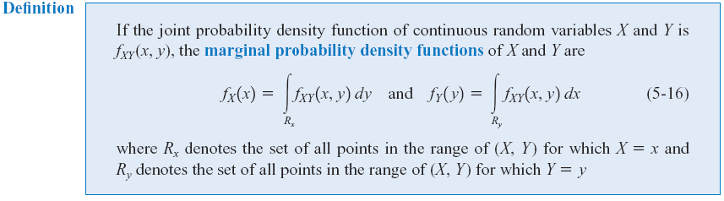
Marginal Probability Distributions(Continuous)
Similar to joint discrete random variables, we can find the marginal probability distributions of X and Y from the joint probability distribution.

Slide 42
Marginal Probability Distributions(Continuous, Example)
Compute f_{X} (x) and f_{Y}(y) in Example 7

Slide 43
Independence
In some random experiments, knowledge of the values of X does not change any of the probabilities associated with the values for Y.
If two random variables, X and Y are independent, then

Slide 44
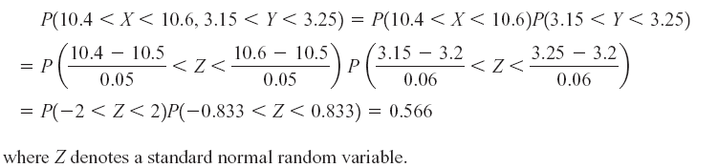
Independence (Example 8)
Let the random variables X and Y denote the lengths of two dimensions of a machined part, respectively.
Assume that X and Y are independent random variables, and the distribution of X is normal with mean 10.5 mm and variance 0.0025 (mm)² and that the distribution of Y is normal with mean 3.2 mm and variance 0.0036 (mm)².
Determine the probability that 10.4 < X < 10.6 and 3.15 < Y < 3.25.
Because X,Y are independent

Slide 45
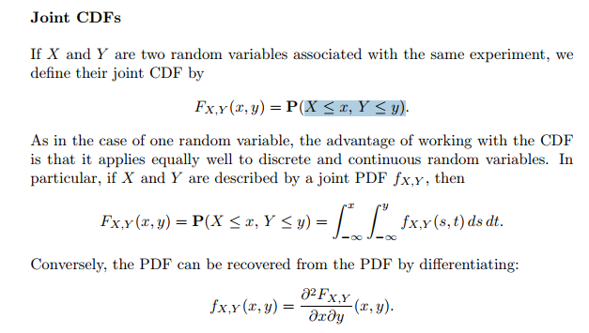

Slide 46

Function of random Variable Find the CDF and PDF of Y

Slide 47
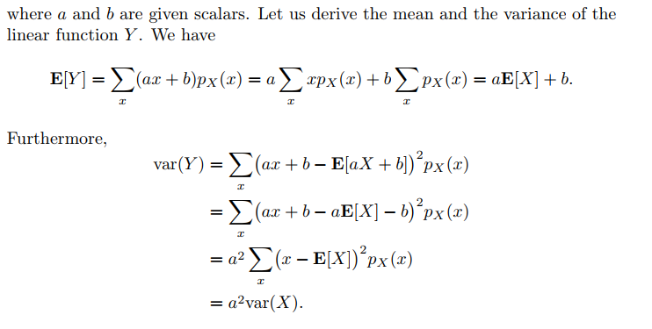

Slide 49
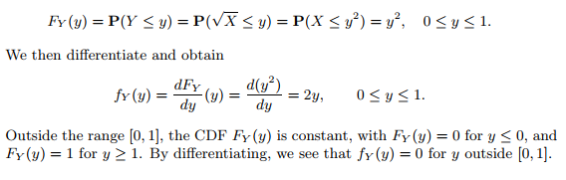

Slide 50


Slide 51
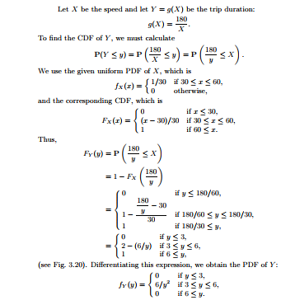

Slide 52


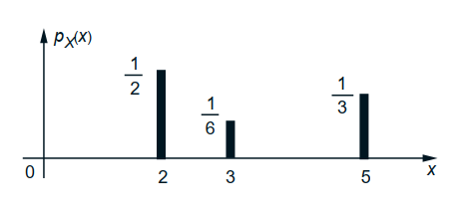

Moment Generating Function

Slide 53
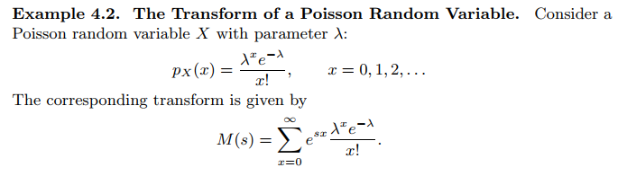
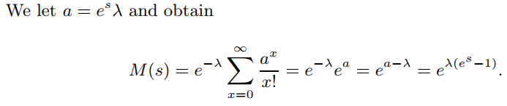

Slide 54
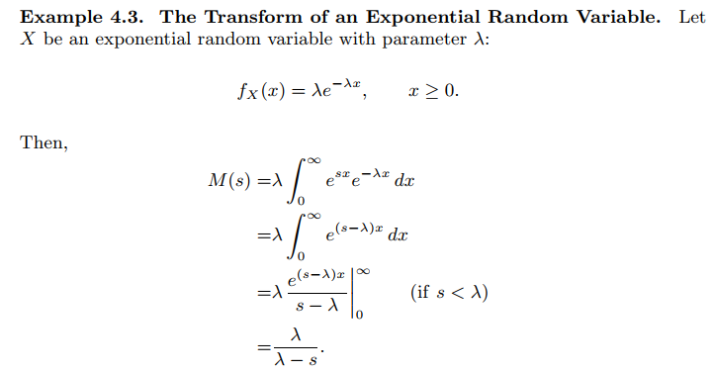

Slide 55
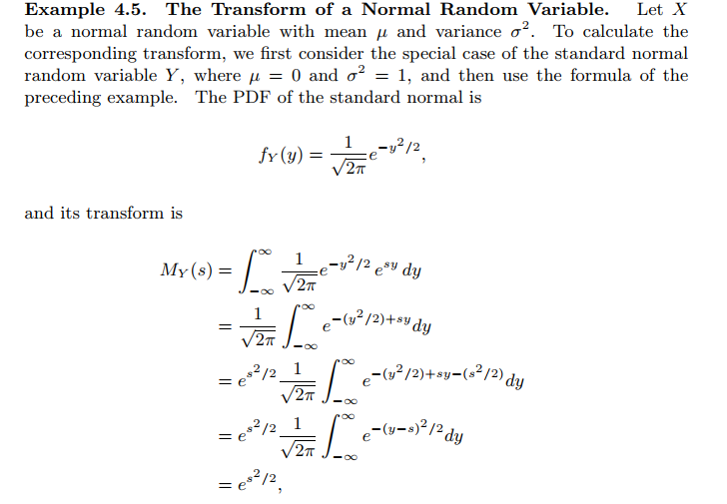

Slide 56
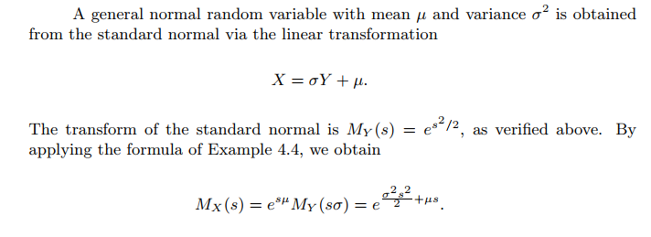

Slide 57
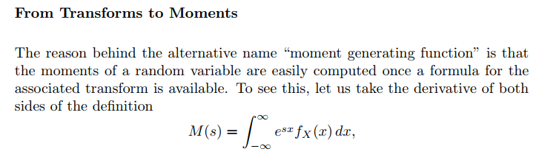
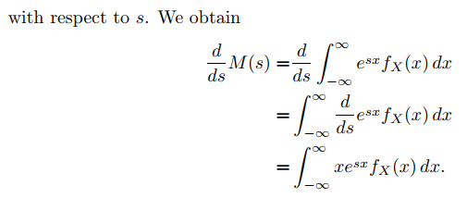

Slide 58
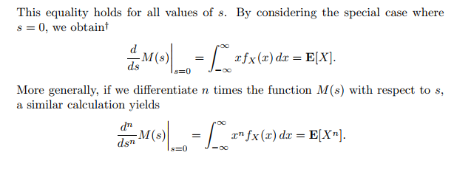

Slide 59
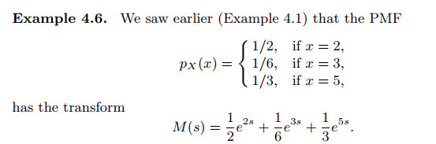
Find mean and variance using MGF

Slide 60
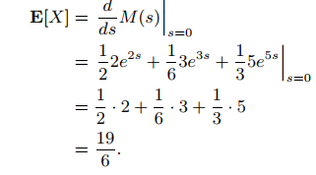


Slide 61


Slide 62


Slide 63


Slide 64
Covariance and Correlation Coefficient
The covariance between two RV’s X and Y is
Properties:
The correlation Coefficient of X and Y is
Notes:
When we are interested in the joint distribution of two random variables, it is useful to have a summary of how much the two random variables depend on each other. The covariance and correlation are attempts to measure that dependence.

Slide 65

Covariance and Correlation (Example 6 (Cont.))
Marginal PMF
f_{X}(1)=P(X=1,Y=1)+P(X=1,Y=2)=0.1+0.2=0.3
f_{X}(3)= P(X=3,Y=1)+P(X=3,Y=2)+ P(X=3,Y=3)=0.2+0.2+0.3=0.7
f_{Y}(1)= P(X=1,Y=1)+P(X=3,Y=1)=0.1+0.2=0.3
f_{Y}(2)=P(X=1,Y=2)+P(X=3,Y=2)=0.2+0.2=0.4
f_{Y}(3)= P(X=3,Y=3)=0.3

Slide 66


Covariance and Correlation
Example 9

Slide 67

Covariance and Correlation
Example 9 (Cont.)

Slide 68

Covariance and Correlation
Example 9 (Cont.)

Slide 69
Zero Covariance and Independence
However, in general, if Cov(X,Y)=0, X and Y may not be independent.
Example 10: X is uniformly distributed on [-1,1], Y=X² . Then,
Cov(X,Y)= 0, but X determines Y, i.e., X and Y are not independent.
If X and Y are independent, then Cov(X,Y)=0.

Slide 70

Bivariate Normal Distribution
Notes:
ρ: Correlation coefficient X, Y are independent if ρ = 0
The bivariate normal distribution is the joint distribution of certain linear combinations of independent random variables havign standard normal distributions. The bivariate normal distribution arises directly and naturally in many practical problems. For examle, the heights and the weights of the individuals in the population will be approximately a bivariate normal distribution.

Slide 71

Bivariate Normal Distribution
Example 11
Notes:
Unfortunately, there is often no closed-form solution to probabilities involving bivariate normal distributions. In this case, the integration must be done numerically.

Slide 72
Bivariate Normal Distribution (Matlab)
y = mvncdf(xl,xu,mu,SIGMA) returns the multivariate normal cumulative probability with mean mu and covariance SIGMA evaluated over the rectangle with lower and upper limits defined by xl and xu, respectively. mu is a 1-by-d vector, and SIGMA is a d-by-d symmetric, positive definite matrix.
Examples 11 (Cont.)
mu=[3.00 7.70]; SIGMA=[0.0016 0.00256; 0.00256 0.0064];
XL=[2.95 7.60];
XU=[3.05 7.80];
>> p=mvncdf(XL,XU, mu,SIGMA)
p =
0.6975

Slide 73
Next class Tutorial discussion.
Be ready with all questions-answers, Student will be asked to solve on board randomly.
Thank You!!

